Slide 1
Autonomous Mission Management of Unmanned Vehicles using Soar
Scott Hanford
Penn State Applied Research Lab
Distribution A
Approved for Public Release; distribution is unlimited

Slide 2
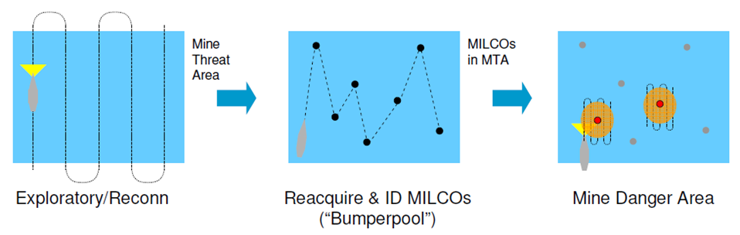
MCM background
UUVs used to automate parts of Mine Countermeasures (MCM) mission
Interest in autonomously altering missions based on sensor data obtained during mission
Goal of our project: collaborate with NSWC-PCD to explore use of cognitive architecture for management of established autonomy capabilities

Slide 3
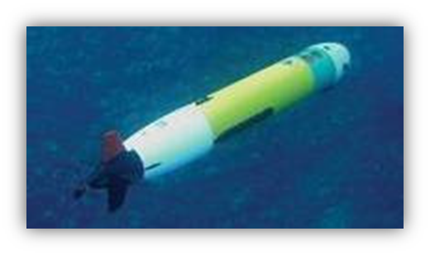
Representative MCM autonomy
Launch
Spiral
Transit
Survey
Transit
Loiter at pickup
Mission Script
Task Spooler
Behaviors
Transit
Survey
Loiter
Spiral
…
Vehicle Controller

Slide 4
Mission Management using Soar
Mission Script
Mission Management
Adaptive Mission Execution (AME)
Autonomous Mission Replanning (AMR)
Explanation Facility
Soar interacts with rest of system using ZeroMQ
Task Spooler
AMR
Soar Mission Manager
AME
Behaviors
Transit
Survey
Loiter
Spiral
…
Vehicle Controller

Slide 5
Explanation Facility
Goal is for users (MCM operators & SMEs, not necessarily Soar users) to be able to:
Understand what decisions Soar agent made
What pieces of information were used
Alternatives considered
Identify undesirable decisions and provide context for agent developer to investigate
This talk
Mechanisms used to help generate explanations
Examples of explanations

Slide 6
Initial explanation
Sensor input indicates UUV depth (180.56) is below maximum allowable depth
Elaboration tests that UUV depth is below maximum depth threshold – creates WME indicating fault condition
E17
^fault-condition
below-max-depth
Operator to manage depth problem proposed to manage-safety-fault based on existence of fault-condition
O11
^name
manage-safety-fault
^fault-condition
When operator is applied, an explanation is generated (without details of UUV depth):
below-max-depth
Missing what input caused this condition to be recognized
Fault condition: below-max-depth condition recorded.

Slide 7
Storing elaborated information
Alter elaboration that tests that UUV depth is below maximum depth threshold fault to save additional information
E17
^fault-condition
N35
^supporting-wmes
S21
^value
^measured-value
^threshold
below-max-depth
Operator proposed to manage depth problem has additional attribute to reference specific fault condition triggering proposal
180.0
180.56
O11
^name
manage-safety-fault
^fault-condition
below-max-depth
^condition-id
N35

Slide 8
Generation of explanation
E1
Create explanation object in WM using information from operator attributes
^explanation
E23
^fault-condition
180.56
^measured-value
Use elaboration to copy supporting WMEs from WM object stored in id
F38
^id
^threshold
N35
180.0
^condition-type
^string
below-max-depth
Use another elaboration to generate explanation based on attributes present
Fault condition: below-max-depth condition recorded. UUV depth (180.136) is below maximum depth threshold (180.0).

Slide 9
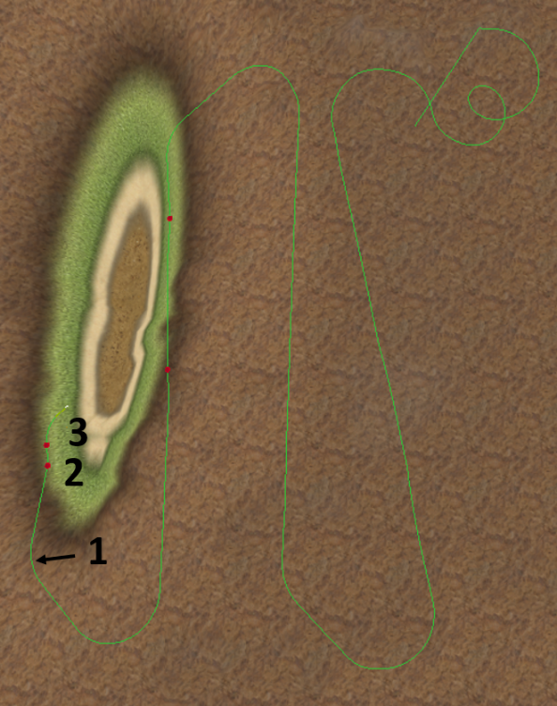
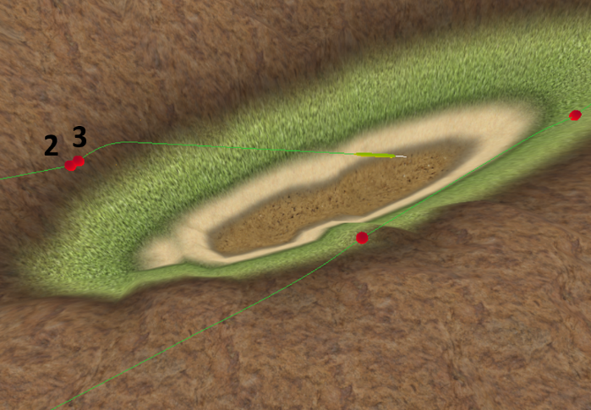
Agent-generated explanation
Agent output:
<698.6> Mission status: UUV has started navigation to waypoint 1 of survey behavior.
<736.7> Fault condition: below-max-depth condition recorded. UUV depth (180.10) is below maximum depth threshold (180.).
<736.7> Fault strategy generation: Soar agent generated strategy to resolve below-max-depth condition: UUV commanded to maintain depth (at 175.).
<738.2> Successful fault strategy: strategy to maintain depth (at 175.) has decreased UUV depth (179.97) above maximum depth threshold (180.).
<738.2> Mission status: UUV can not return to behavior's desired control mode, continue using fault strategy to maintain depth (at 175.).
<738.2> Mission strategy: Abandon track number 4 (waypoint 1) because altitude is too high relative to altitude intended for survey.
1
2
3

Slide 10
Explanation of alternatives
Soar mission manager will ideally have more than one tactically appropriate strategy to consider when a decision is necessary
Want to explain rationale for choosing one strategy over another
Encode each possible strategy as a Soar operator
Propose each strategy whenever it is tactically appropriate
Use operator preference rules to select between multiple tactically appropriate operators based on context
In RHS of operator comparison rule, add information to preferred operator about the operator it is preferred over

Slide 11
Alternative strategy explanation
Agent output:
<115.7> Agent has detected that currents are affecting mission progress.
<115.7> Vehicle recorded as being in the volume layer of current when detection that currents are affecting mission progress first occurred.
<115.7> Change depth to 15. meters to attempt to search for more favorable current in surface current layer.
<115.7> Also considered changing altitude to 5. meters to search for more favorable current in bottom, but distance to move in water column to reach bottom (263.6 m) was greater than distance to move to surface layer (85.3 m).
Surface
Volume
Bottom
3 layers of current: surface, volume, bottom
Consider attempting to transit in different layer → prefer closer layer

Slide 12
Summary
Nuggets
Have used Soar to increase robustness of representative UUV autonomy by adapting behaviors
Explanation of decisions useful to understand how agent has applied domain specific knowledge
Coal
Access to complexity of context to fully demonstrate usefulness of Soar’s capabilities can be challenging
This material is based upon work supported by the Office of Naval Research under grant number N00014-10-G-0259/0031. Any opinions, findings, and conclusions or recommendations expressed are those of the authors and do not necessarily reflect the views of the sponsor.

